Slide 1
Employee Salary Management System

Slide 2
Student Name:
1) Anita Ingawale
2) Sakshi Kathe

Slide 3
Introduction
The Employee Salary Management System is a software application designed to simplify and automate the processes involved in salary management. From calculating salaries based on attendance to generating pay-slips and tracking employee performance, this system streamlines administrative tasks, saving time and reducing errors.

Slide 4
Purpose
The purpose of the Employee Salary Management System is to provide a centralized and automated solution for managing all aspects of employee salaries within an organization.
This includes tasks such as calculating salaries, tracking attendance, managing allowances and deductions, generating pay slips, and ensuring compliance with legal and regulatory requirements.

Slide 5
Requirements
Tools : Spring Tool suite and
MYSQL
Language : SpringBoot,React
Query Language : SQL

Slide 6
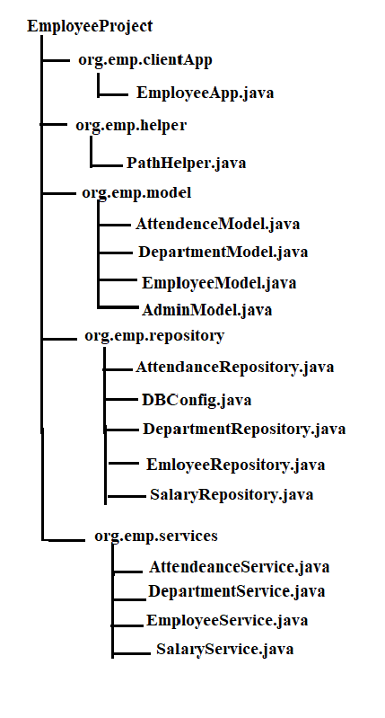
Flow Diagram :

Slide 7
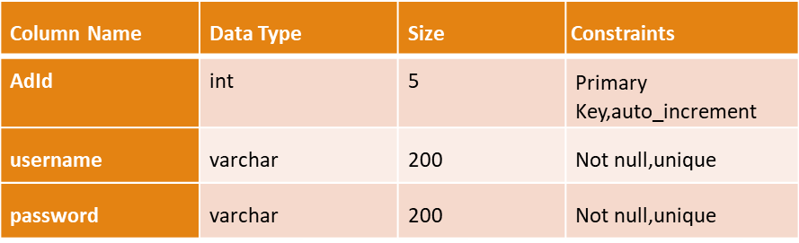
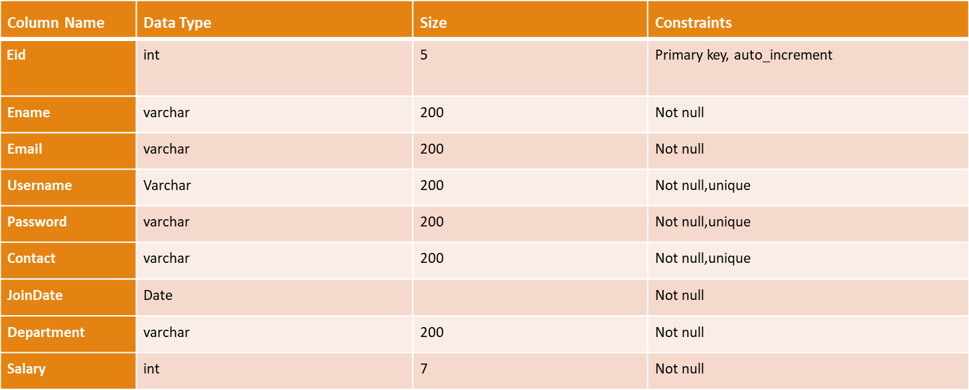
Admin :
Employee :

Slide 8
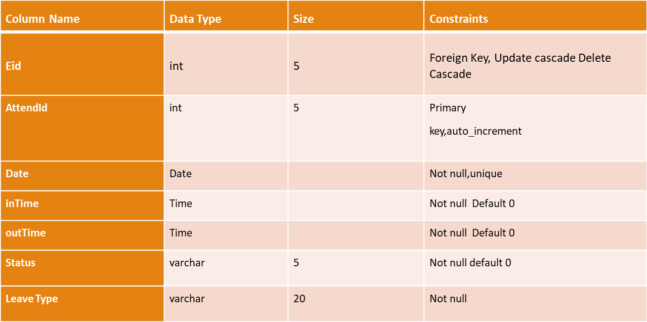
TABLES :
Attendance Table :

Slide 9
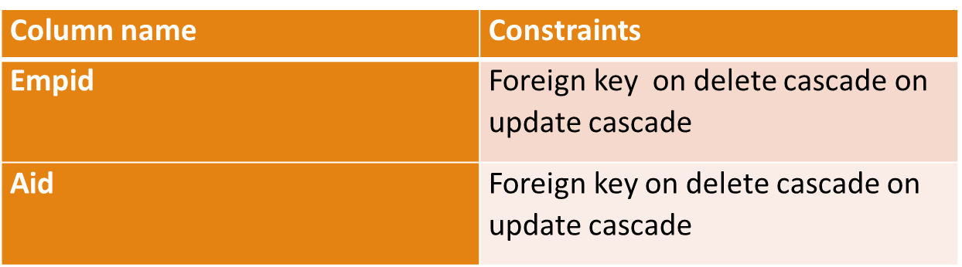
EmpAttendanceJoin :

Slide 10
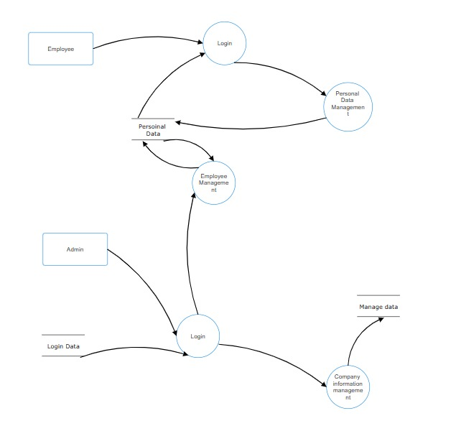
Data flow diagram

Slide 11
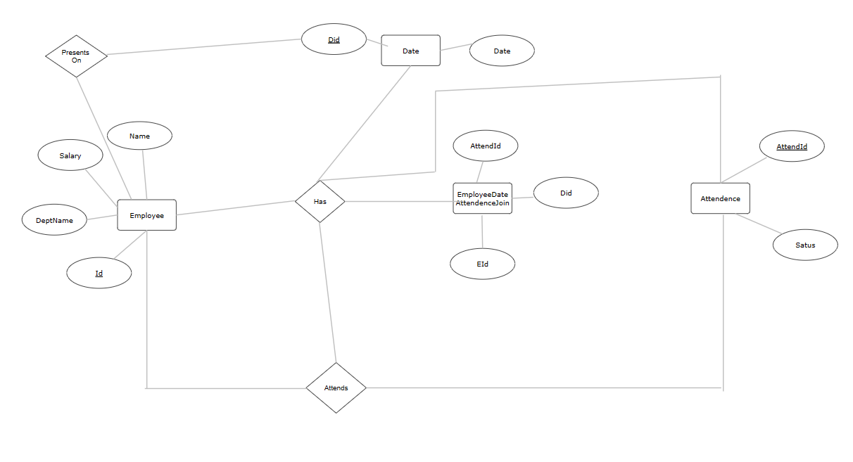
ER-Diagram

Slide 12


Slide 13


Slide 14


Slide 15
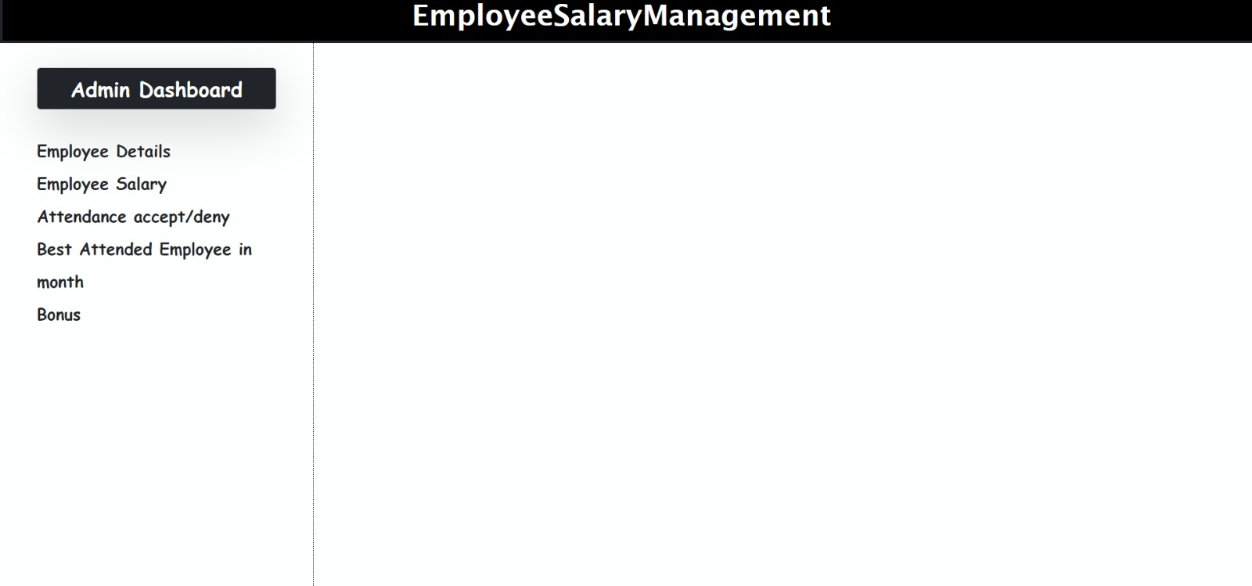

Slide 16
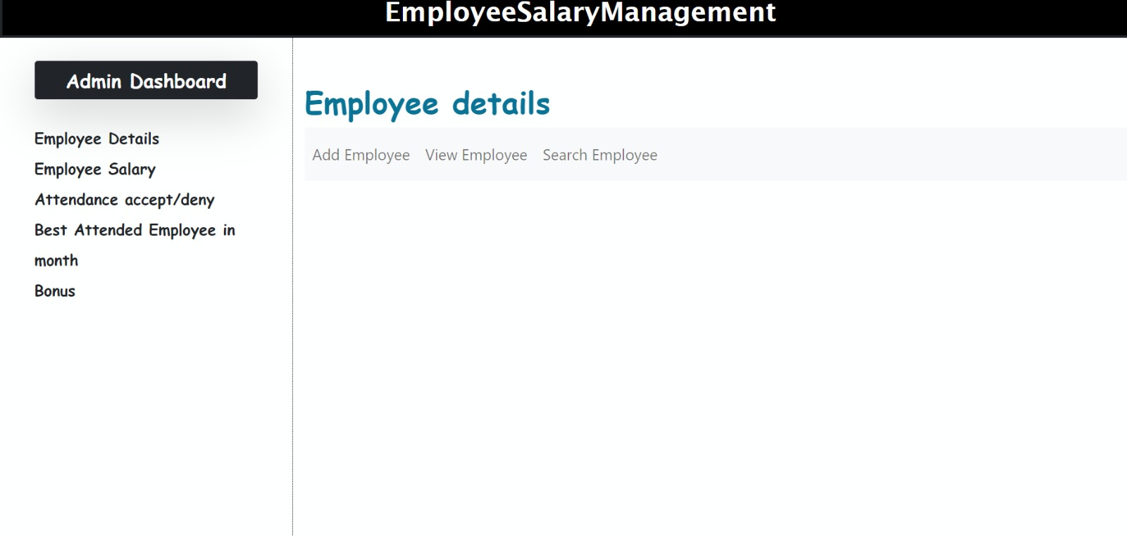

Slide 17
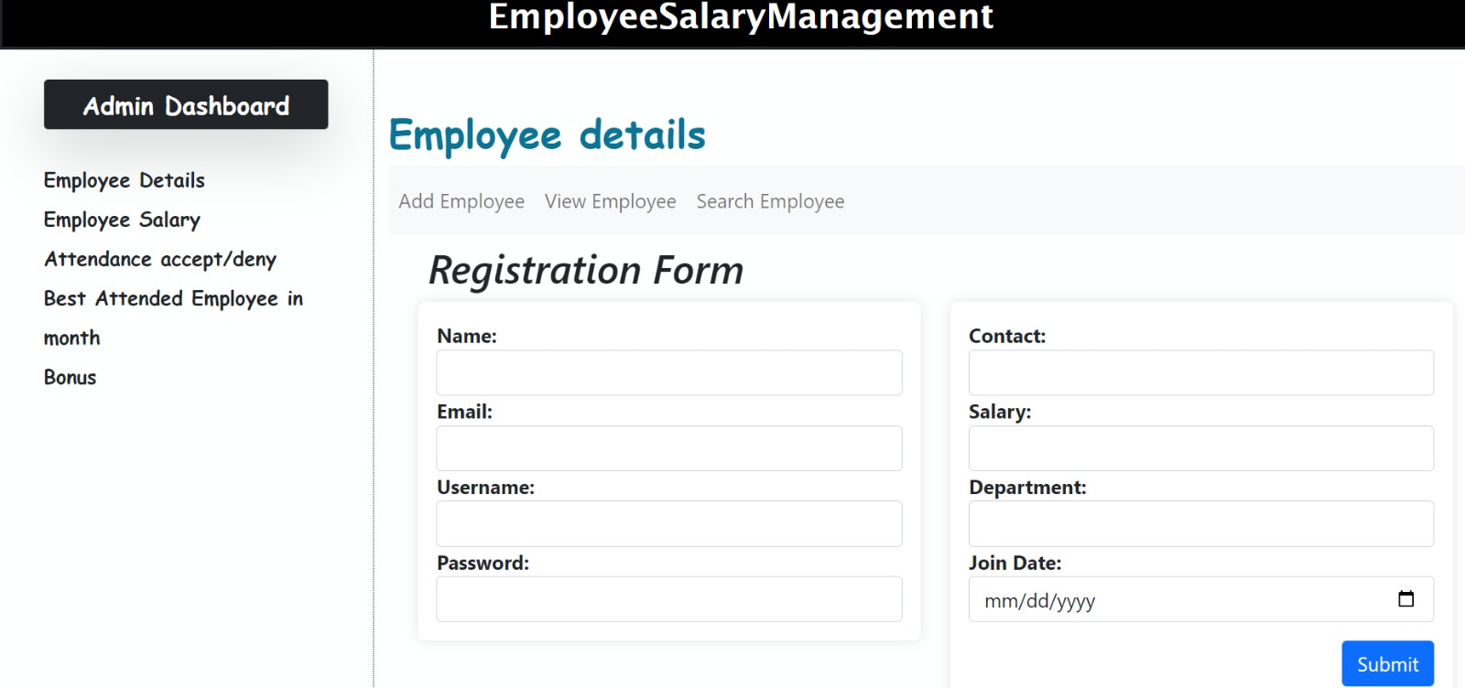

Slide 18
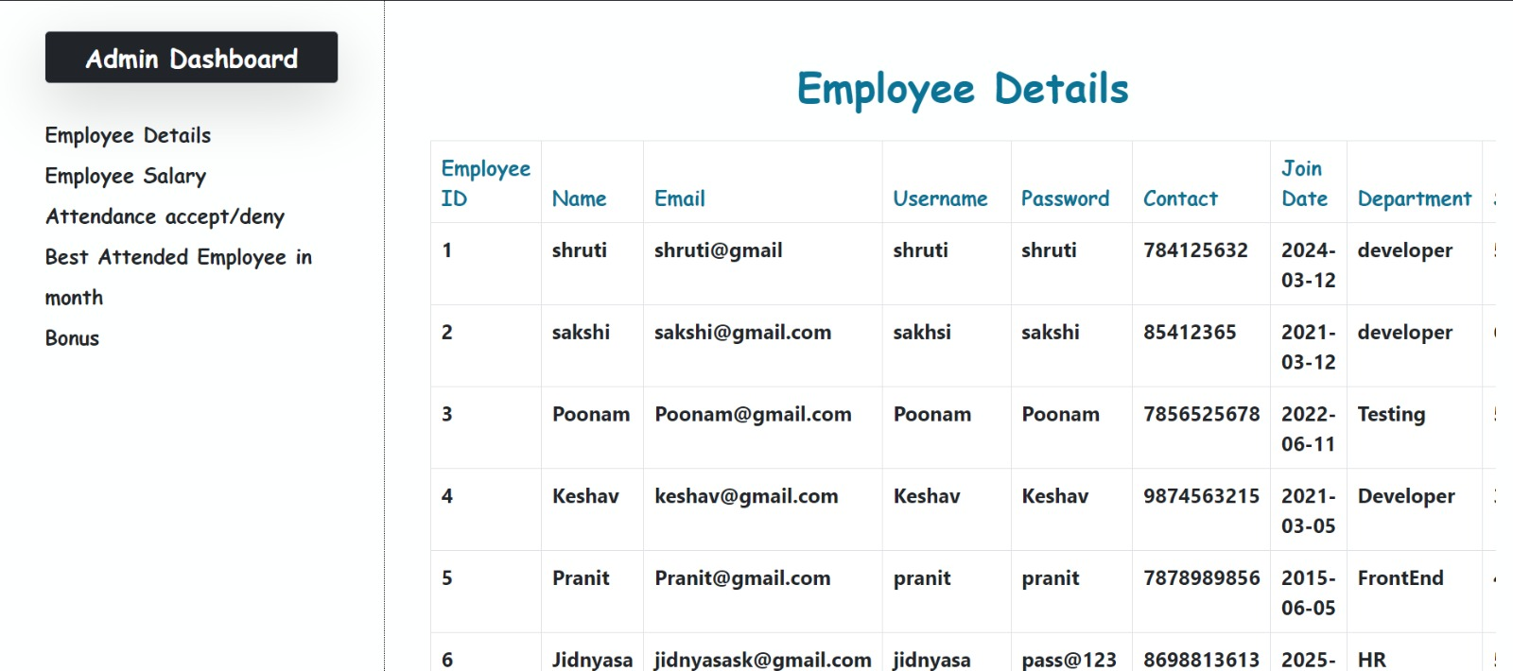

Slide 19


Slide 20


Slide 21
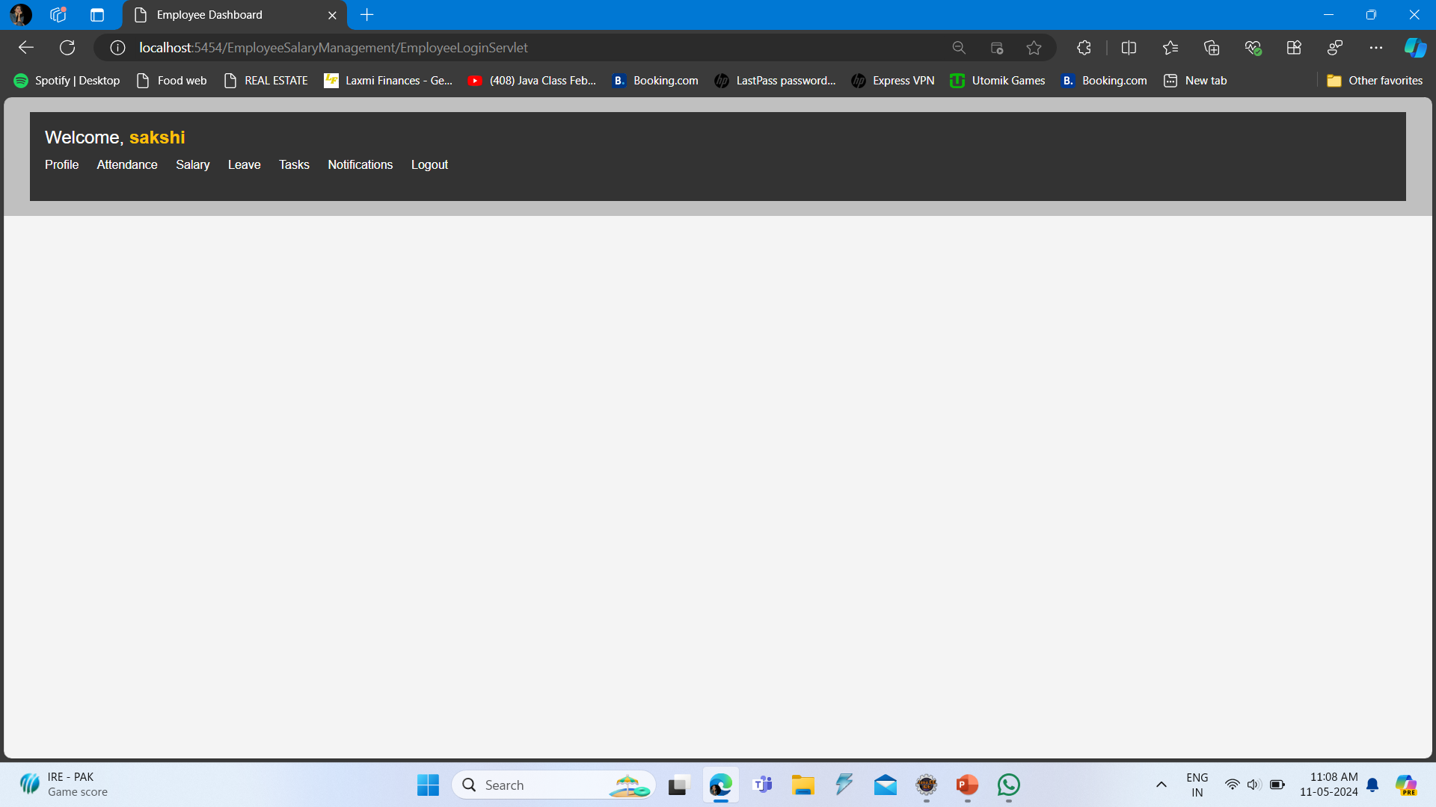

Slide 22
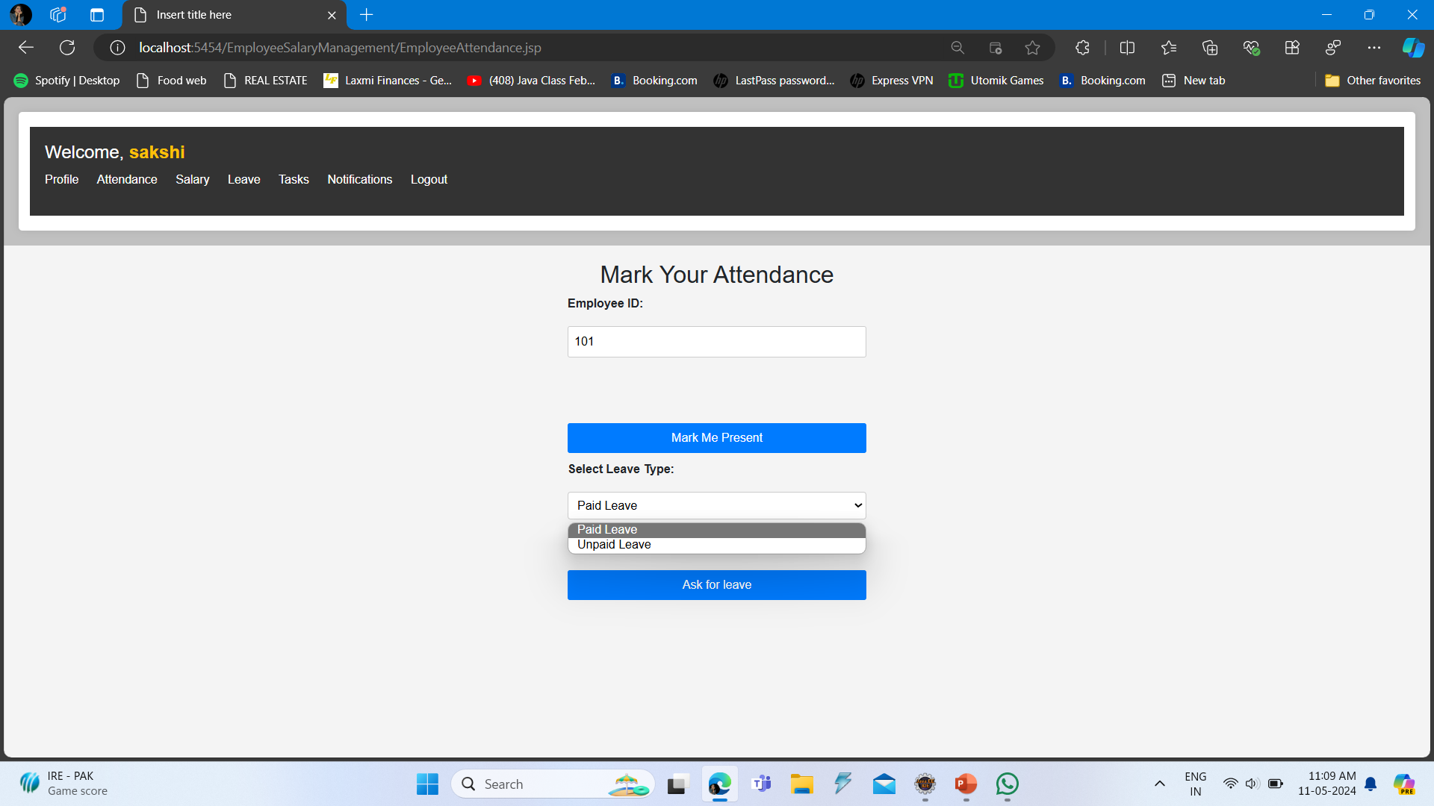

Slide 23
Advantages
Saves Time and lowers the error ratio.
Eliminates the stress of processing all the records.
Manage Employee information efficiently.
Generate and manage the salary process according to the salary structure assigned to the employee.
Manage the Security

Slide 24
Limitations
Initial Investments
Technical Complexity
Data Security Risks
Careful Planning

Slide 25
Conclusion
The employee Salary Management System offers significant advantages in streamlining salary-related processes, enhancing organizational efficiency, and improving employee satisfaction. By automating tasks such as salary calculation, attendance tracking, and reporting, the system reduces manual effort, minimizes errors, and ensures compliance with legal and regulatory requirements.

Slide 26
Thank You!!

